Slide 3
OK
START
SET BACKGROUND

Slide 5
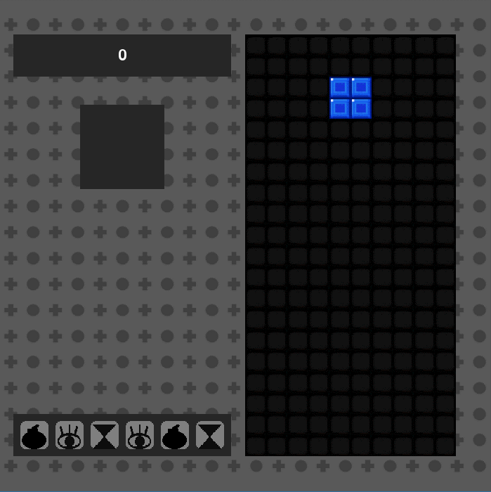
Rotate
Score
Left
Right
Down or Space
Next tetromino view
Left Ctrl

Slide 6
Game Over

